Slide 1

T Level
Results and Certification

Slide 2
Why T Levels?
The Government plans to reform technical education, moving to a simplified system based on routes to employment, with T Levels as a flagship qualification. The core purpose of T Levels is to prepare students for direct entry into skilled employment (including higher level apprenticeships), and therefore will be rigorous, classroom based technical study programmes.
Notes:
This is one of three T Level streams, the other streams are
Marketing and Communications
introduce them to T Levels and explain how they work
Industry Placements Matching
find local providers with suitable opportunities for students
2

Slide 3
Results and Certification
create a register of T Levels
record which Awarding Organisations offer a combination of pathways and specialisms that make up a TQ
record which providers are approved to run the T Levels that an Awarding Organisation is offering
record learner’s completion and assessments for pathways, specialisms, MARs, IPs, Maths and English
calculate a learner’s T Level result at the completion of their learning
print T Level Certificates or Certificates of Achievement

Slide 4
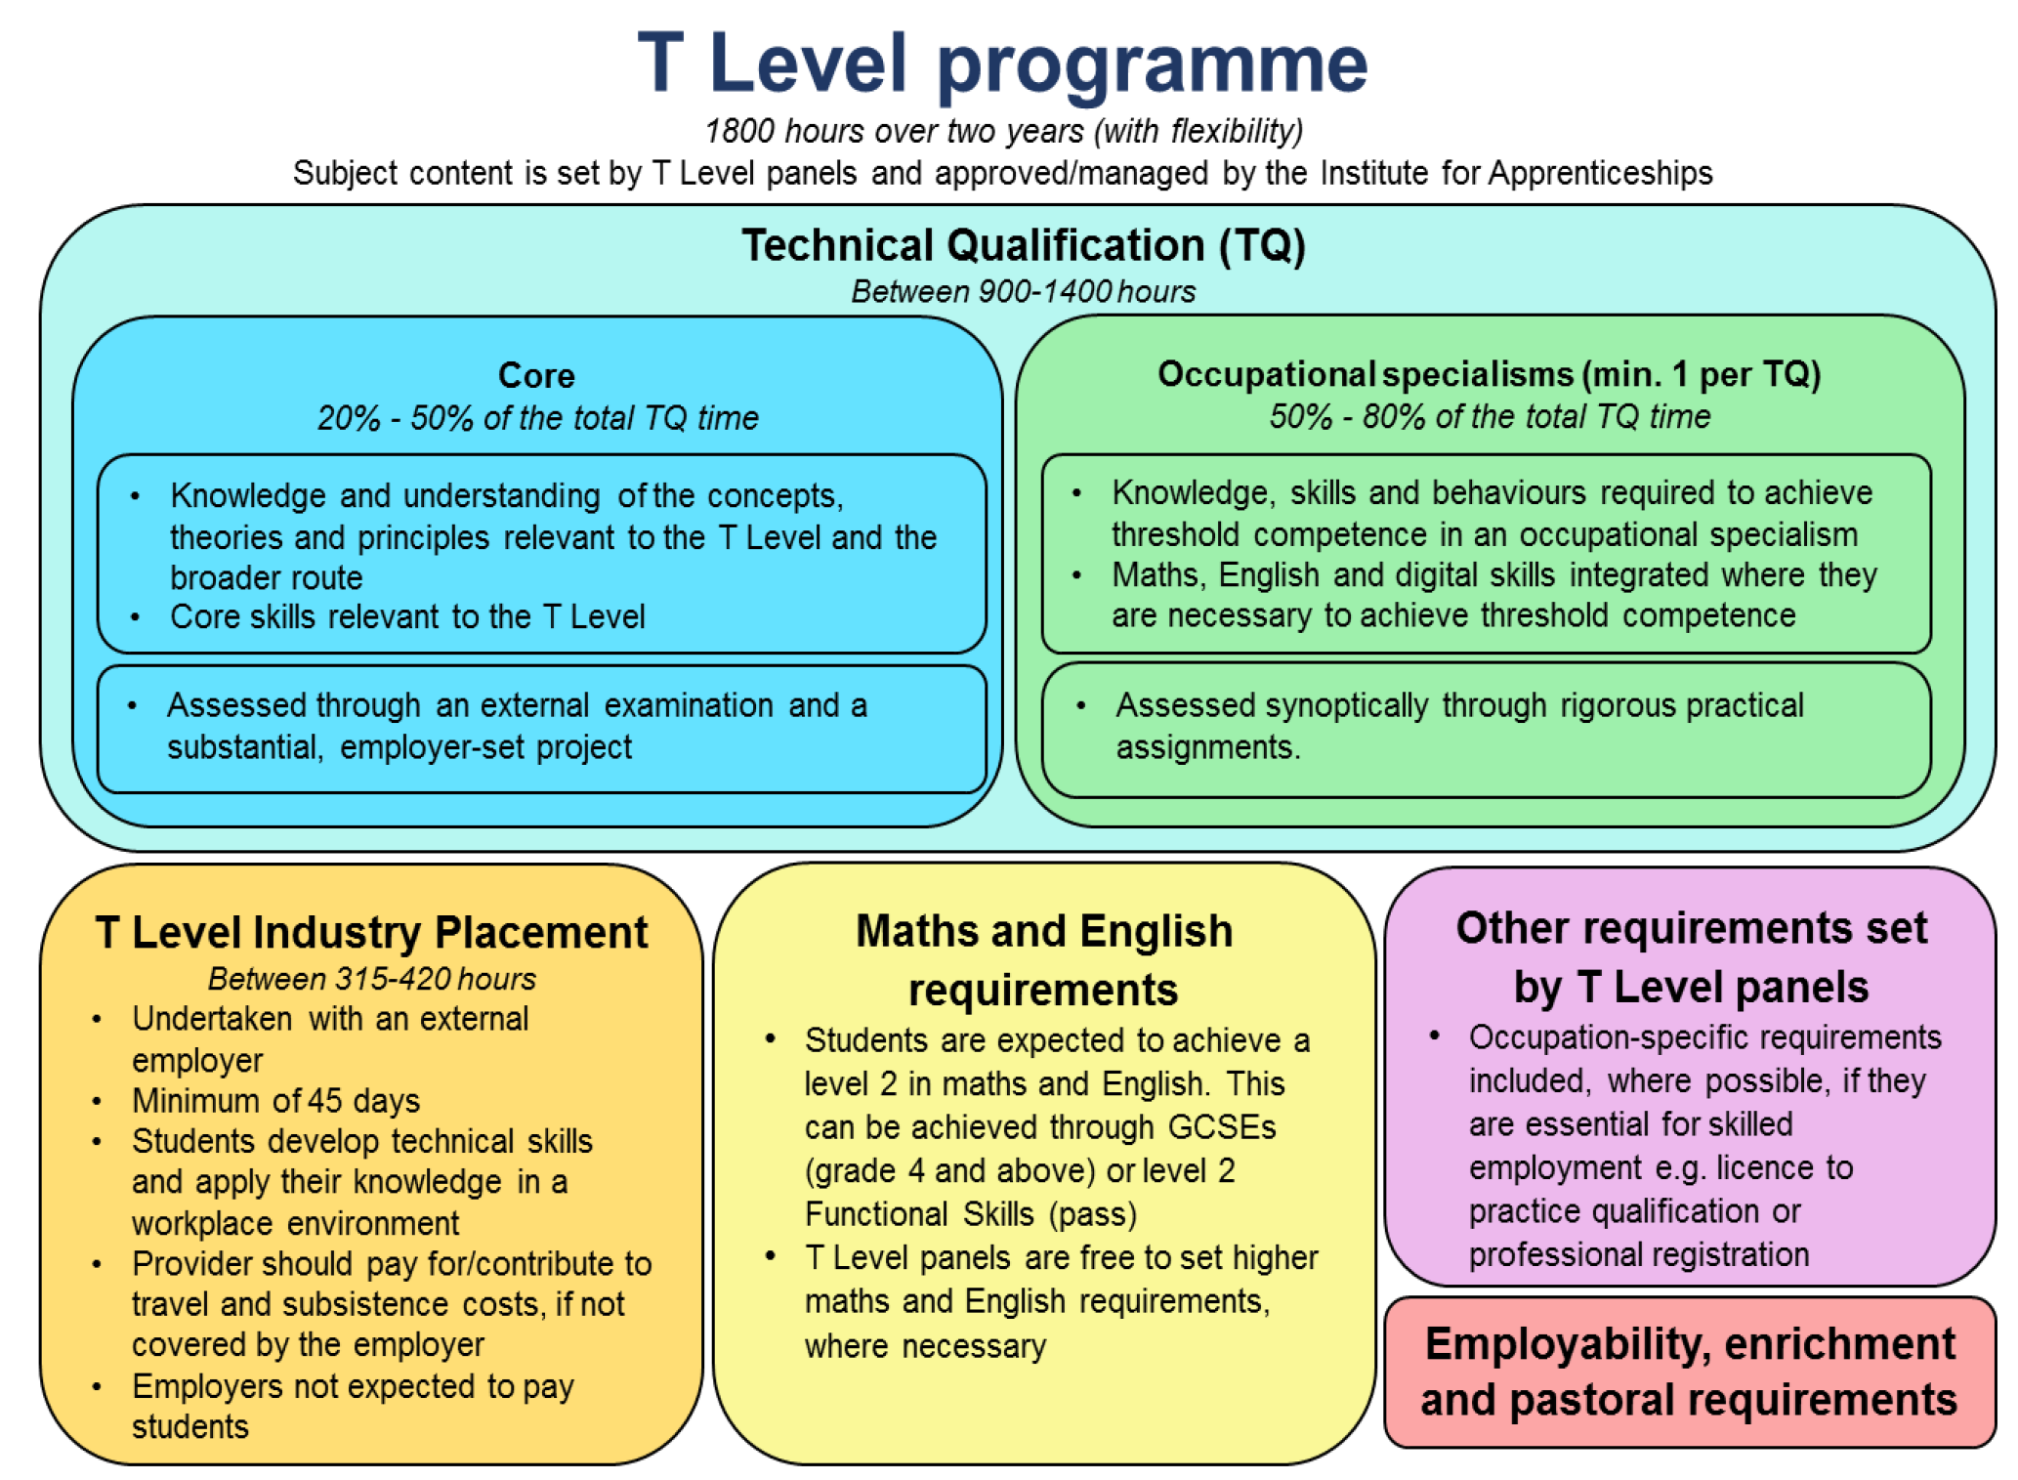

Slide 5
Design principle
The T Level Results and Certification will adhere to the following design principles
Enterprise data will be accessed from an authoritative source rather than duplicated
To obliviate storage of redundant data by storing data once in authoritative sources, and retrieving it using common identifiers therefore maintaining referential integrity
To use loosely coupled objects with no interdependencies, to ensure that a change made within one object will not create unanticipated changes within other elements. This simplifies testing, maintenance and troubleshooting procedures.

Slide 6
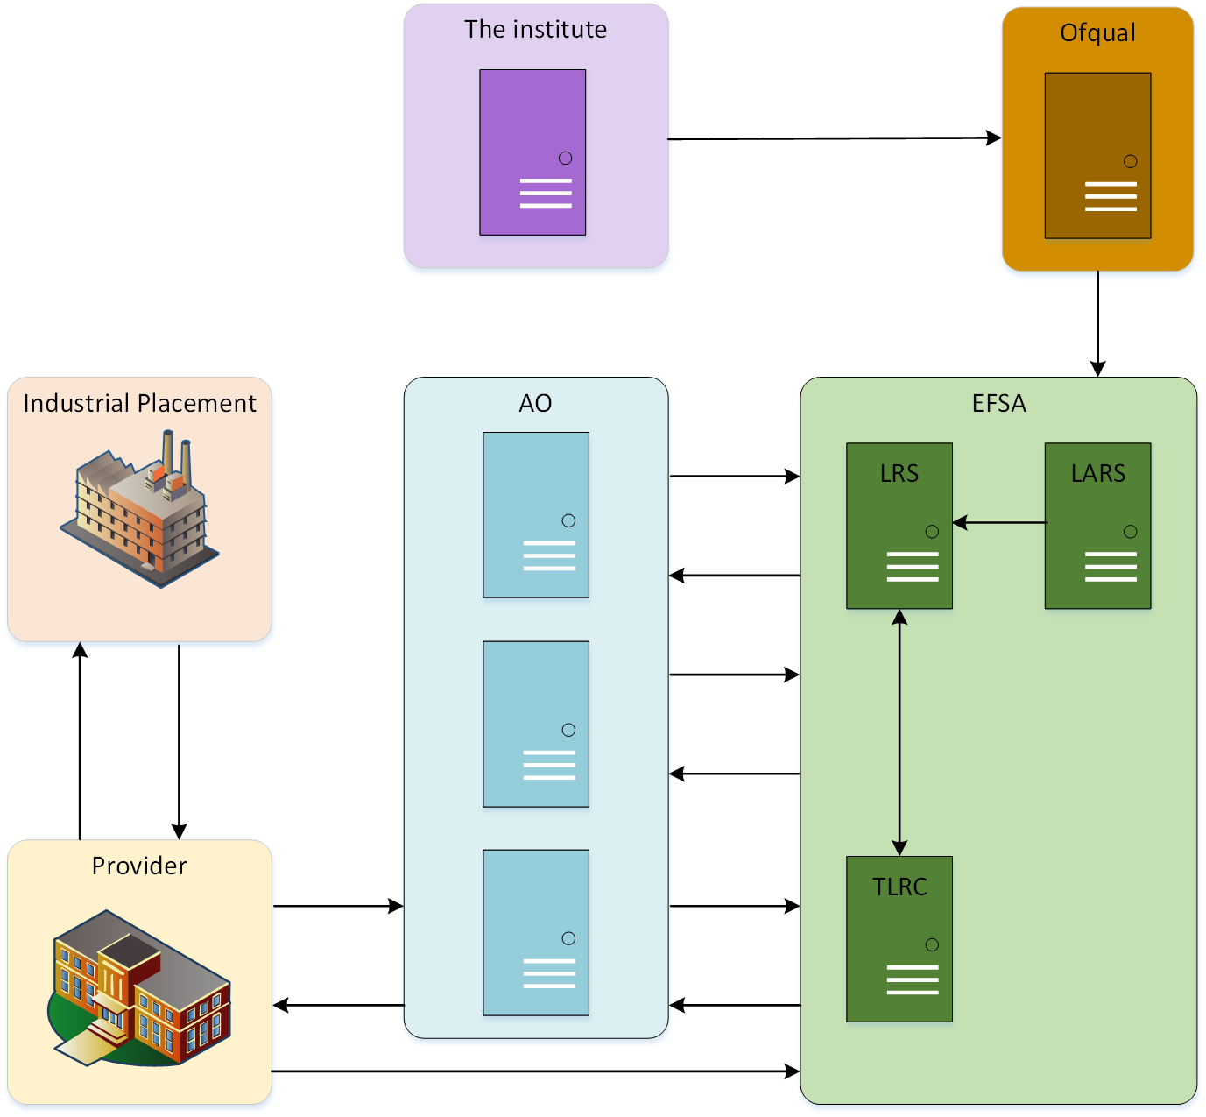
T Level organisations

Slide 7
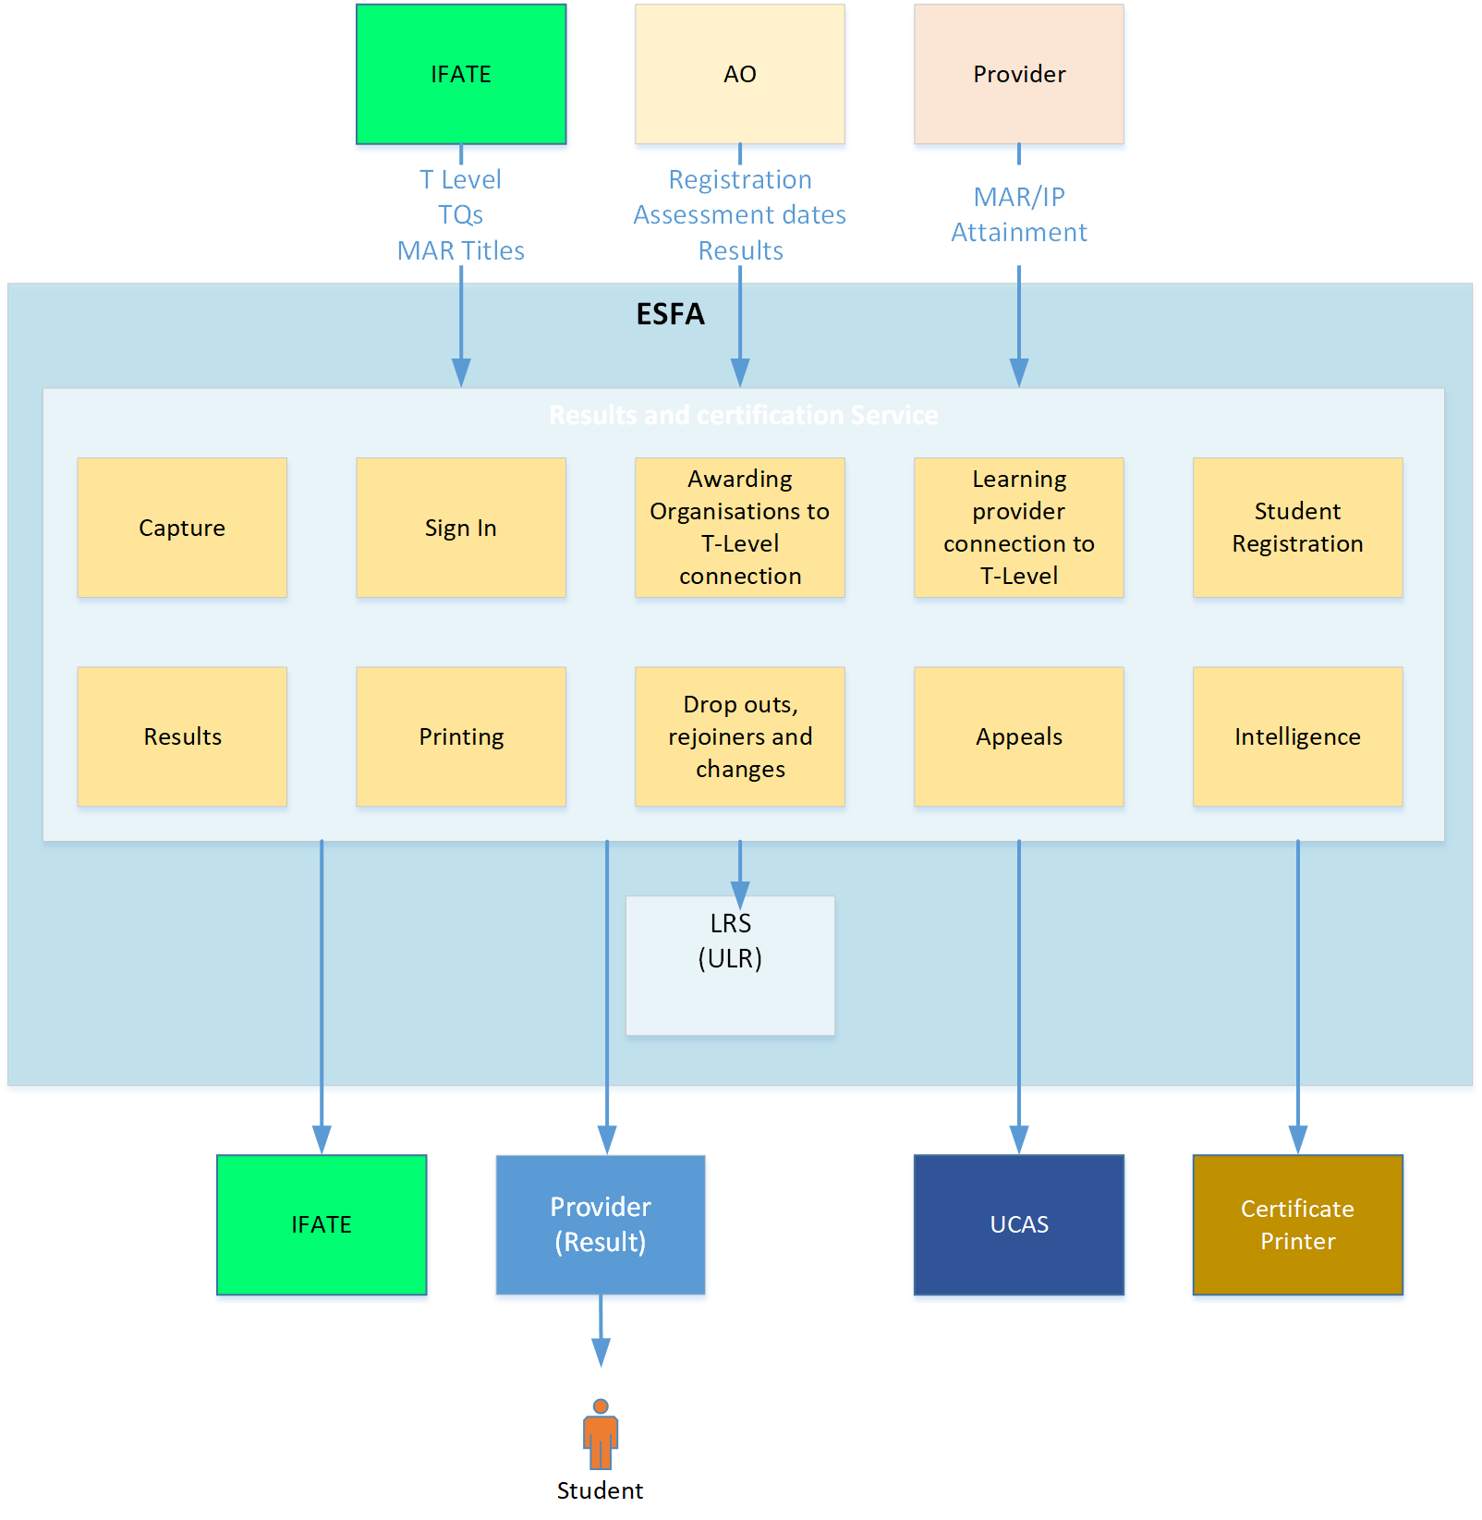
Solution concept

Slide 8
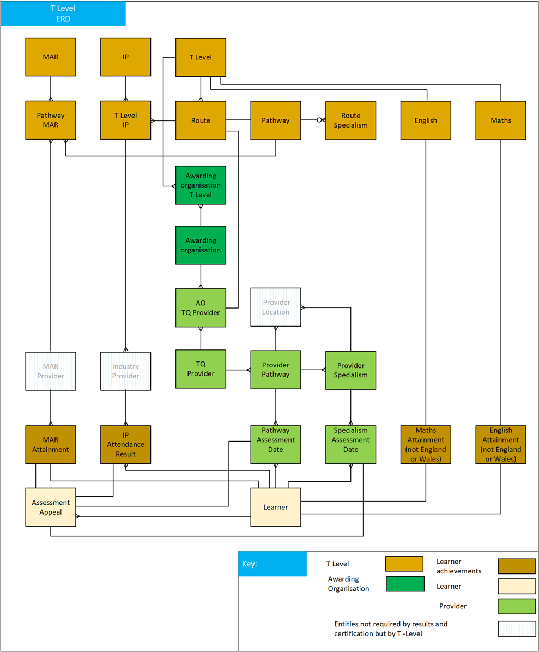
ERD

Slide 9
Data sources
Data | Source | Key
Learner | ULR | ULN
Pathway & results | ULR | ULN
Specialism & results | ULR | ULN
Maths (England & Wales) | ULR | ULN
English (England & Wales) | ULR | ULN
Maths equivalent | T Level | ULN
English equivalent | T Level | ULN
IP | T Level | ULN
MAR | T Level | ULN, Pathway Id
Awarding organisation | LRS | RN Number
Awarding organisation Pathway location | T Level | RN Number Pathway Id
Awarding organisation Specialism location | T Level | RN Number Specialism Id
Learning providers | UKRLP | UKPRN

Slide 10
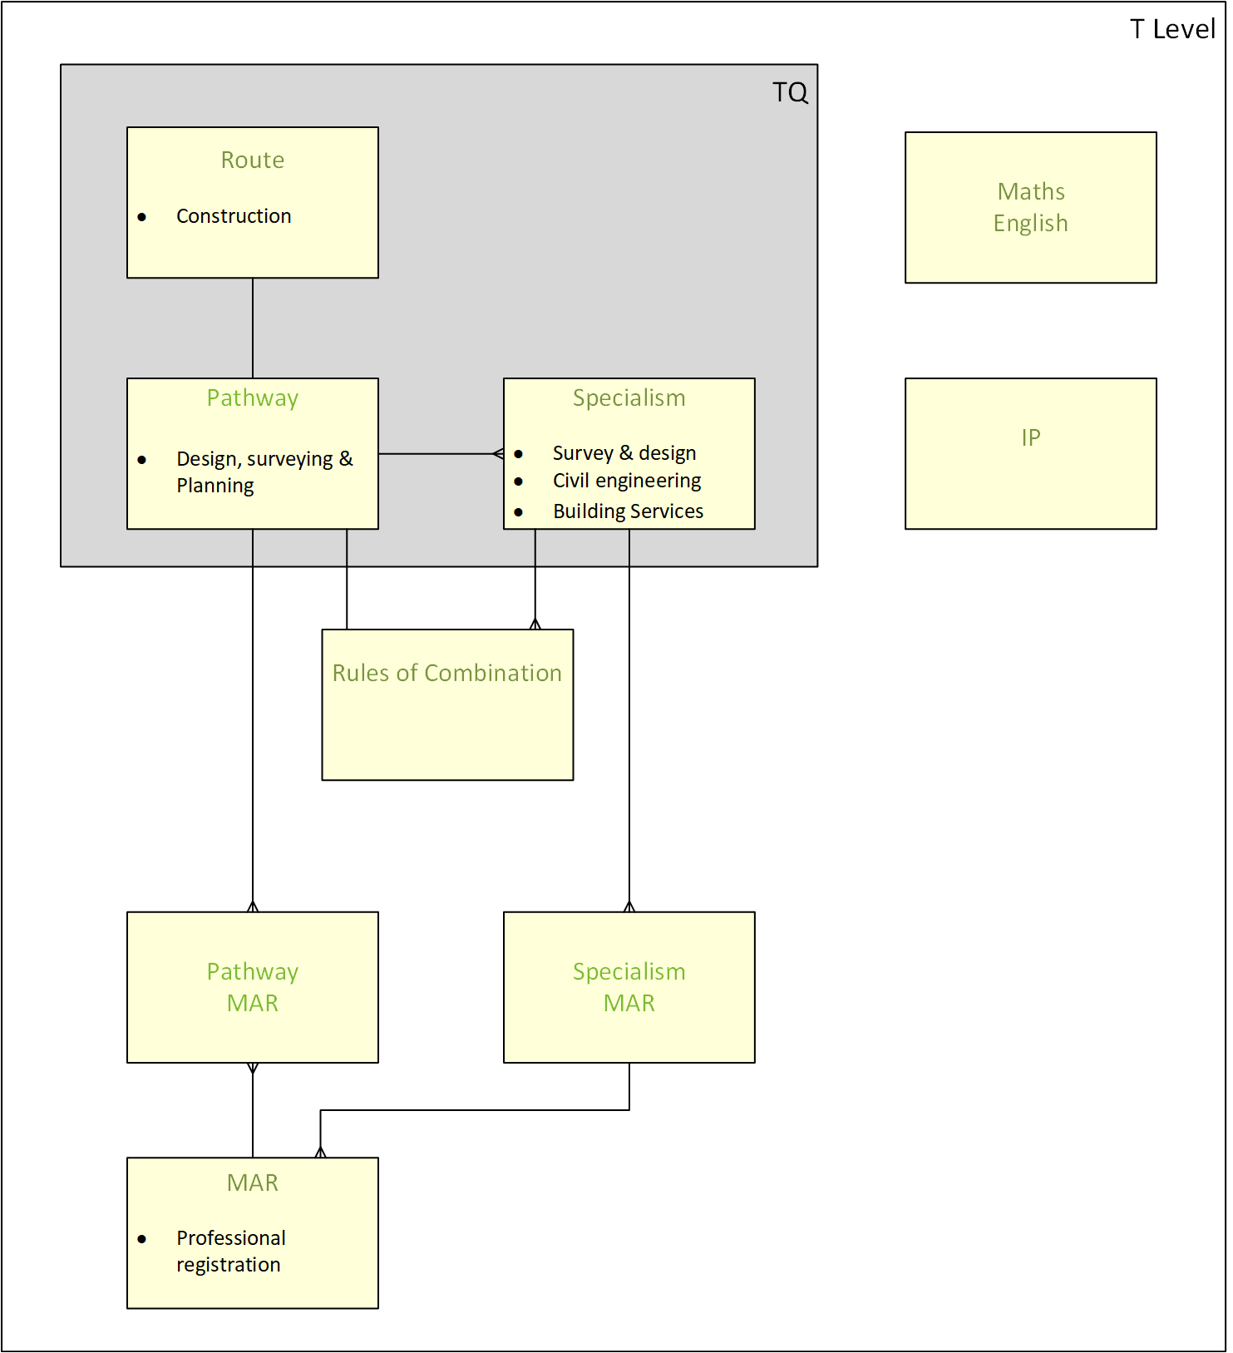
T Level structure

Slide 11
Significant functional / non-functional requirements
Peaks in results arriving, just before A Level results. All T Level assessment and attainment data will be received eight working days before results are due to be released.
There will be peaks in printing, although not so time critical
The system will generate a reminder for Awarding Organisations and Providers for the entry and completion of attainments and assessments.
Result calculations will be calculated seven working days before the T Level results release date.
T Level certificate printing will be scheduled to take place at a date yet to be determined.
On demand T-Level certificate and Statement of achievement printing
The maximum file sizes for data transferred from Awarding Organisations and Providers has yet to be determined.
There will be a significant growth in the number of learners taking T-Levels, as follows:
2,300 entrants in 2020
66,500 upon roll-out of all pathways in 2023
120,500 following full national roll-out in 2029

Slide 12
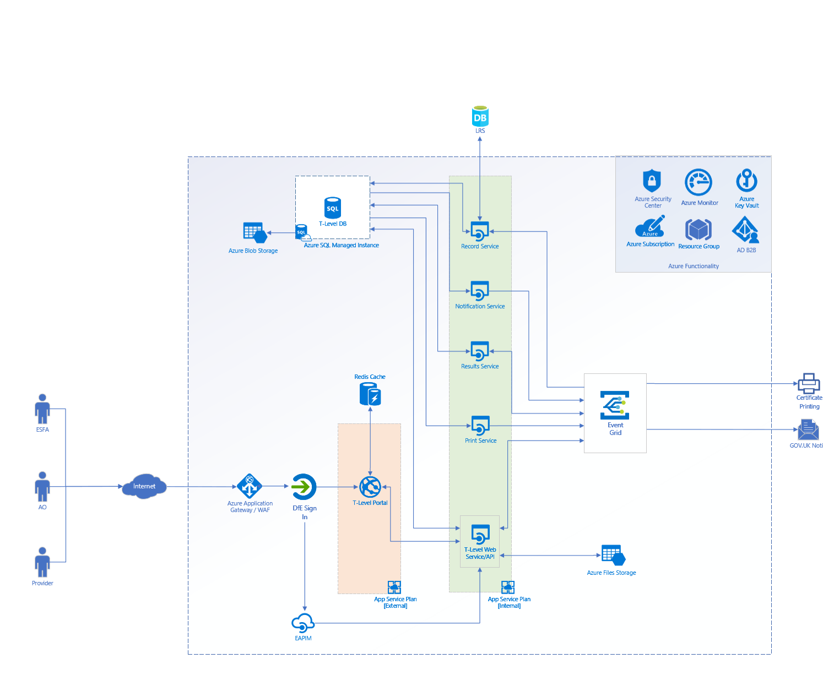
Data transfers
Notes:
Our Services
Record Service Sends pathway, specialism and T Level results to LRS Retrieves learner names for all learners
Notification Service Notifies AOs and Providers of missing component assessments and attainments
Results Service Calculates T Level results
Print Service collects the information for printing certificates en bulk

Slide 13
Notes:
Assessment result will now come into R

Slide 14
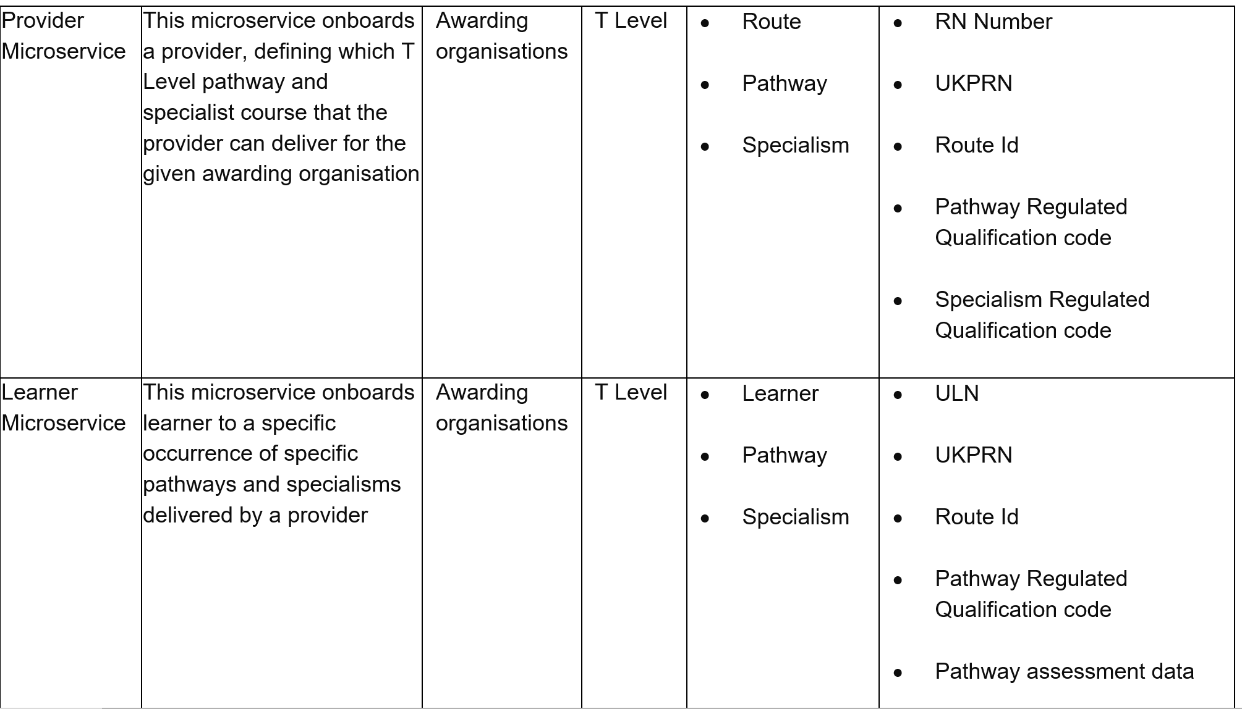

Slide 15
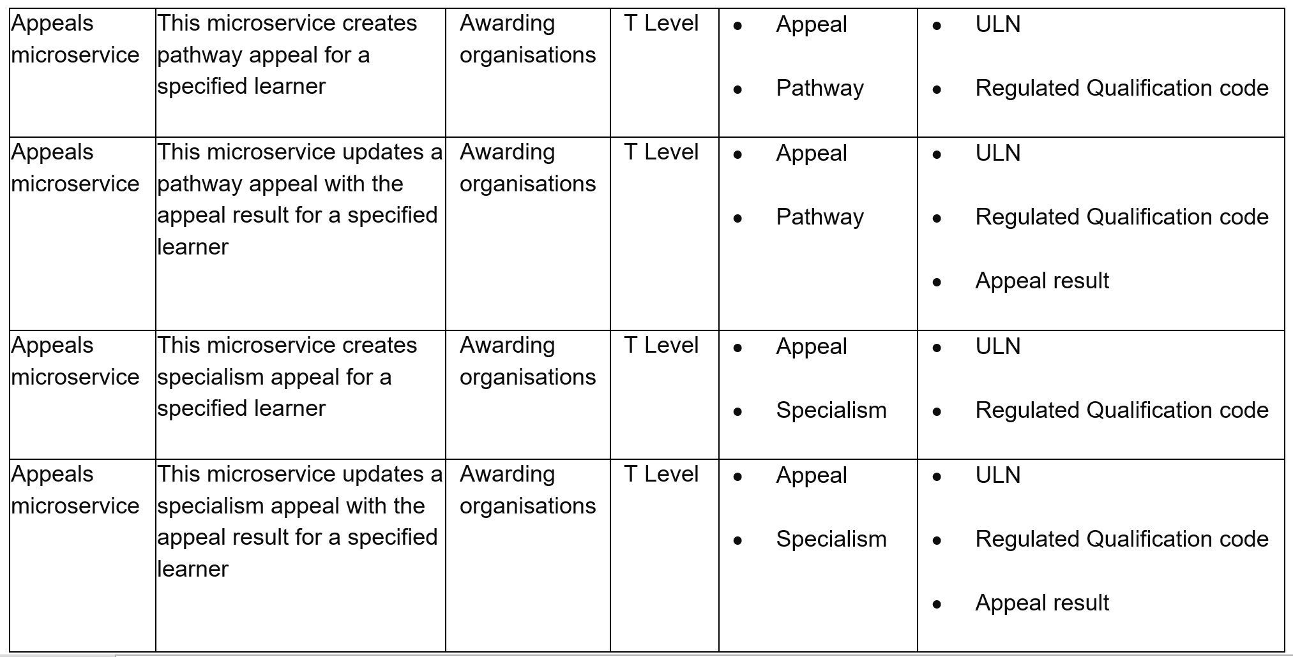

Slide 16
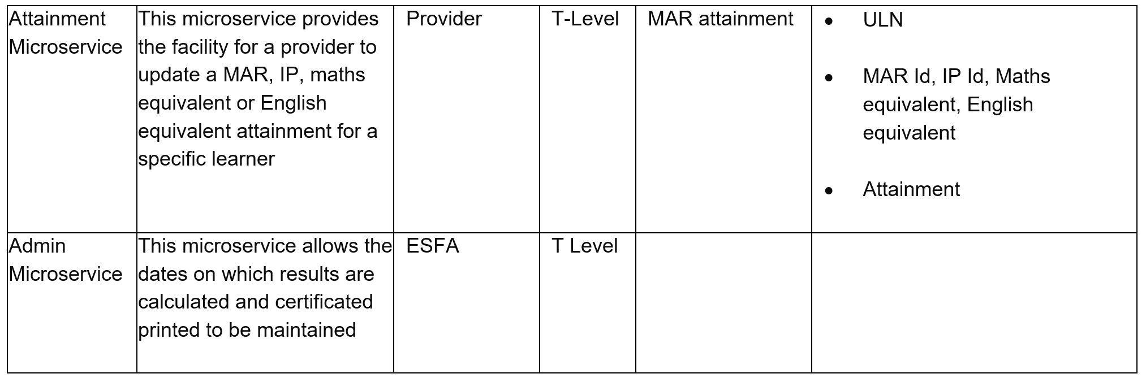

Slide 17
Risks
Ref. | Description | Risk (H/M/L) | Impact (H/M/L) | Owner | Mitigation
R.01 | T Level system needs to be in production in time for learner registration at the end of October 2020 | L | H | Gary Flanagan | A series of MVPs will be delivered to enable the system to go live in incremental stages, leading up to learner registration to ensure that all preparatory work can be carried out in advance.
R.02 | Short time frame for the AOs to develop and test the APIs | M | M | Gary Flanagan | A portal will be provided which will offer an alternative way in which AOs can enter data into the system as part of the MPV.
R.03 | Industry placements not completed before the results calculation cut off point | M | H |  | Providers incentivised to ensure that industrial placements are completed

